Slide 1
CS3200 Project - MusicDB
JAEJIN Lee, Duy vu, Nam nhat luu

Slide 2
Background Info
Listeners of different music platform
Local drive music library/database
In order to find one song, need to search on each online service
Global music info catalog
Store library’s info, addition of telling us where we can find songs in library

Slide 3
Features
Web GUI interface
Create account, login, manage account
Search, libraries, comment, like, rate song

Slide 4
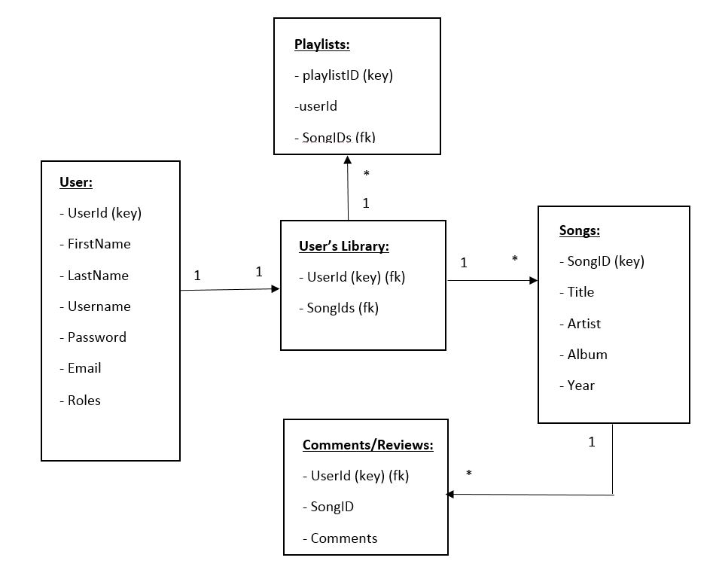
Database diagram

Slide 5
Technical aspects
Front end: AngularJS, HTML, CSS, Jquery
Back end: NodeJS
Database: MySQL with use of nodejs-mysql module
Spotify API for demo catalog

Slide 6
Demo!

